Slide 1



HTTP
Shopping cart
UI
Web Server

Slide 2
HTTP
Shopping cart
UI
Web Server
WebSockets

Slide 3

HTTP
Shopping cart
UI
Web Server
WebSockets

Slide 4
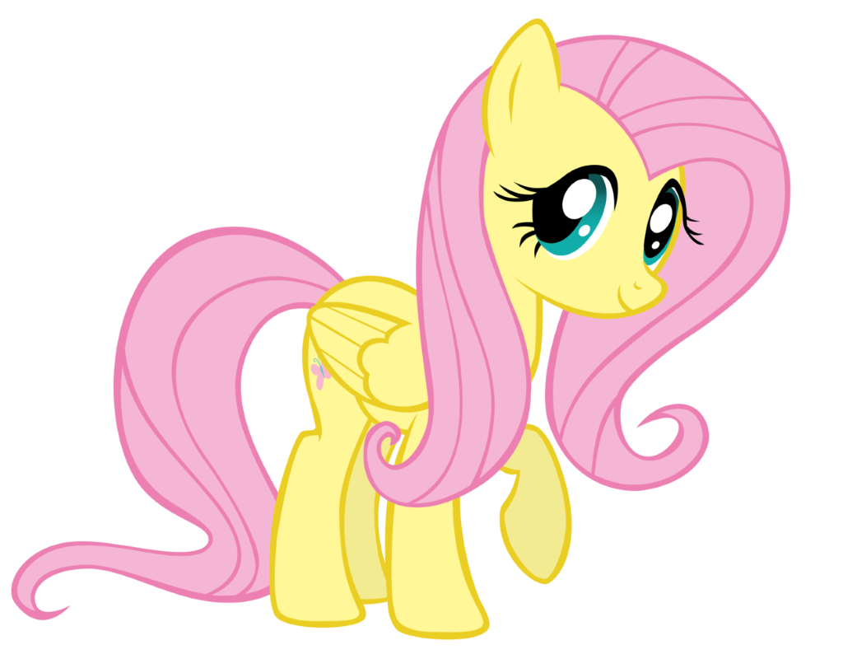
What value does the Web Server add, anyway?

Slide 5
HTTP
Shopping cart
UI
Web Server
WebSockets

Slide 6
HTTP
Shopping cart
UI
WebSockets

Slide 7
HTTP
UI
Shopping cart

Slide 8
UI
Shopping
cart
UI

Slide 9
HTTP
Shopping cart
UI

Slide 10
HTTP
Shopping cart
Batch job
UI

Slide 11
HTTP
Shopping cart
Shipping
UI

Slide 12
HTTP
HTTP
Shopping cart
Shipping
UI

Slide 13
HTTP
HTTP
Shopping cart
Batch job
Shipping
UI

Slide 14

HTTP
HTTP
Shopping cart
Shopping cart
Batch job
Batch job
Shipping
UI

Slide 15

So you decided to build a poor pony’s queue?

Slide 16


HTTP
HTTP
Shopping cart
Batch job
Shipping
UI

Slide 17

I have an idea!

Slide 18
HTTP
Shopping cart
Shipping
UI
UI

Slide 19
Sync
Async
Shopping cart
Shipping
UI

Slide 20

How are you going to send a message and update DB in a transaction?

Slide 21
So you DID decide to build a poor pony’s queue?

Slide 22
NServiceBus.Router
Qpid Dispatch

Slide 23
Shopping cart
Shipping

Slide 24
Shipping

Slide 25
Let’s try commands

Slide 26
How does your app service know what message to send?

Slide 27
You ruined my encapsulation!

Slide 28

Domain Events?

Slide 29
Messages are addressed to entities
- Pat Helland

Slide 30
What happens if you get a duplicate message?

Slide 31
Outbox?

Slide 32

Shipping

Slide 33

Shipping

Slide 34
A
B

Slide 35
You can’t distinguish a duplicate from a retry after failed publish

Slide 36
See? Told you it can be simpler than your Outbox

Slide 37
You need to make ALL side effects idempotent, not only the state change

Slide 38
Aggregate
Process Manager

Slide 39






Input
Core
Output

Slide 40





Slide 41







Slide 42


Slide 43


Slide 45


Slide 46


Slide 49


Slide 50


Slide 53


